Slide 1
Landing Page

Slide 2

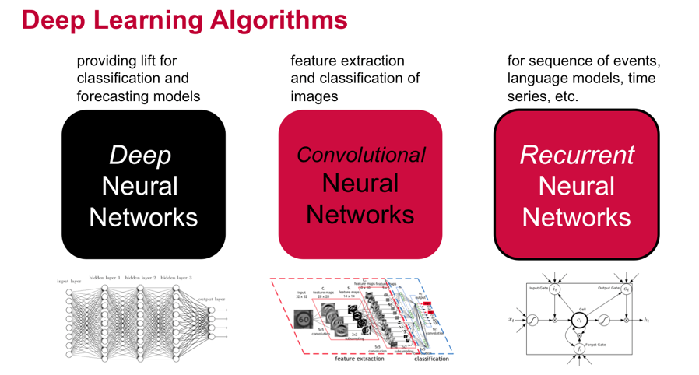

Vipra Hub
Search
Sign In Sign Up Contact Us
Hub of self-contained deep learning models pretrained for a wide variety of applications. VipraHub highlights recent trends in deep learning applications, enables transfer learning approaches, and promotes reproducible science.
Sign Up for VipraHub

Slide 3

Vipra Hub
Search
Sign In Sign Up Contact Us
Hub of self-contained deep learning models pretrained for a wide variety of applications. VipraHub highlights recent trends in deep learning applications, enables transfer learning approaches, and promotes reproducible science.
Sign Up for VipraHub

Slide 4
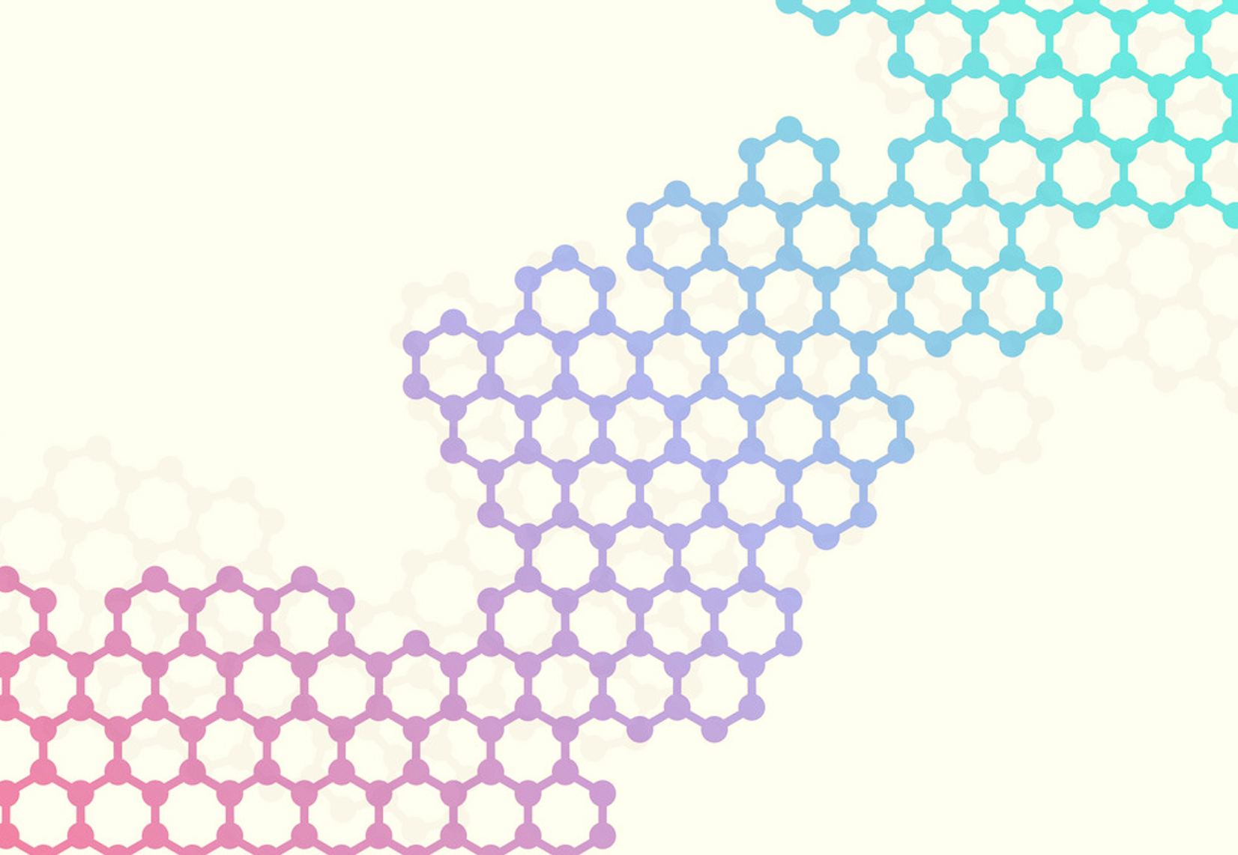

Browse by Categories
Image Classification
Text and language
Sounds and Music
Fairness and Bias
NLP
Pattern Recognition
Voice Recognition
Neural Translation with Attention
CharRNN
Text generation using a RNN with…
Train a sequence to sequence(seq2seq) model for Spanish to English translation using tf.keras and eager execution.
This notebook will let you input a file containing the text you want your generate to mimic, train your model, see the results, and save it for future use all in one page.
Given a sequence of characters from this data (“Shakespeare”), train a model to predict the next character in the sequence (“e”). Longer sequences of text can be generated by calling the model
Browse to see more Models

Slide 5
Why Vipra Hub?
Host your model
Test your model
Visualization
Search other Model
Deploy your model online
Test your model on VipraHub and allow others to test and rate your model
Great Visualization for models and its metadata
Browse models from a list of different kinds of deep learning categories and sort it based on accuracy and rating
Vipra Hub is managed by developers of University of Missouri Kansas City. Contact us for sharing idea or suggestions
© 2019 Team 3

Slide 6
Sign In Page

Slide 7
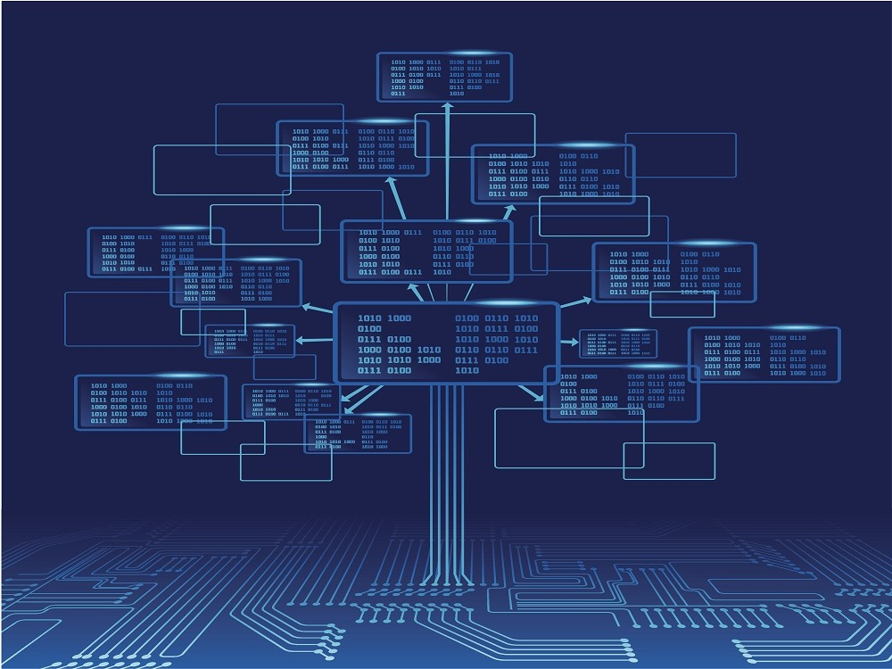


VipraHub
Sign in to VipraHub
Hub of Deep Learning Models self-contained deep learning models pretrained for a wide variety of applications. VipraHub highlights recent trends in deep learning applications, enables transfer learning approaches, and promotes reproducible science.
Email
Password
LOGIN
Forgot your password?
Don’t have an account? Sign up
EXPLORE MODELS

Slide 8
Sign Up Page

Slide 9
VipraHub
Sign up
Last Name
Given Name
Hub of Deep Learning Models self-contained deep learning models pretrained for a wide variety of applications. VipraHub highlights recent trends in deep learning applications, enables transfer learning approaches, and promotes reproducible science.
Email
User Name
Password
Confirm Password
Agree to terms and conditions
SIGN UP
EXPLORE MODELS
Already have an account? Sign in

Slide 10
Search Results Page

Slide 11



Vipra Hub
RNN
Found 412 matches
Image Classification
Text and language
Sounds and Music
Fairness and Bias
NLP
Pattern Recognition
Voice Recognition
Neural Translation with Attention
CharRNN
Text generation using a RNN with…
Author: Henry
Author: Sunanda
Author: James
Train a sequence to sequence(seq2seq) model for Spanish to English translation using tf.keras and eager execution.
This notebook will let you input a file containing the text you want your generate to mimic, train your model, see the results, and save it for future use all in one page.
Given a sequence of characters from this data (“Shakespeare”), train a model to predict the next character in the sequence (“e”). Longer sequences of text can be generated by calling the model
Neural Translation with Attention
CharRNN
Text generation using a RNN with…
Author: Henry
Author: Sunanda
Author: James
Train a sequence to sequence(seq2seq) model for Spanish to English translation using tf.keras and eager execution.
This notebook will let you input a file containing the text you want your generate to mimic, train your model, see the results, and save it for future use all in one page.
Given a sequence of characters from this data (“Shakespeare”), train a model to predict the next character in the sequence (“e”). Longer sequences of text can be generated by calling the model

Slide 12
User Dashboard

Slide 13



Vipra Hub
Search
Recent Activities
Viewed Model1
Done Experiments on Model2
Updated profile
Dharani Muli
Viewed Comments
dharanimuli559@gmail.com
Change password
50
55
30
4.5/5
Delete Account
Private
Public
Uploads
Comments
Downloads
Rating
Image Classification | Model Name | Ratings (/5) | Downloads
Image Classification | Model 1 | 3 | 10
Image Classification | Model 2 | 4.5 | 50
Image Classification | Model 3 | 2 | 0

Slide 14
Sign in to VipraHub
Email
Password
LOGIN
Forgot your password?
Don’t have an account? Sign up

Slide 15
View Model

Slide 16
Thank you

Slide 17
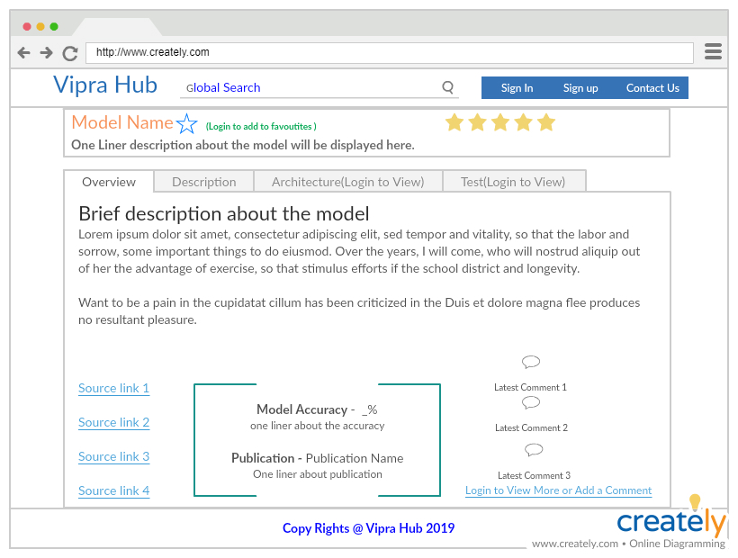

Slide 18
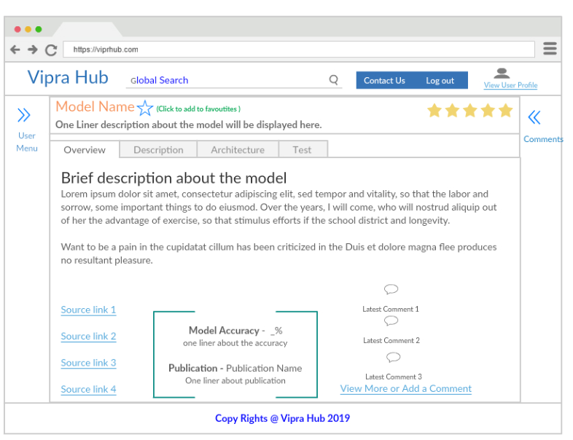

Slide 19
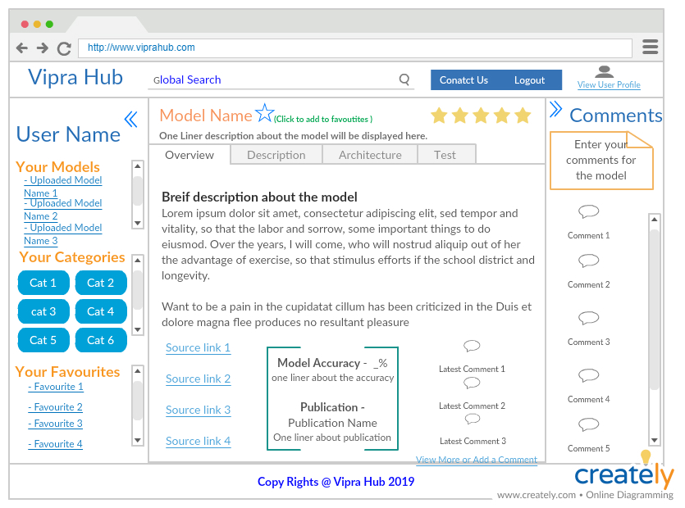

Slide 20
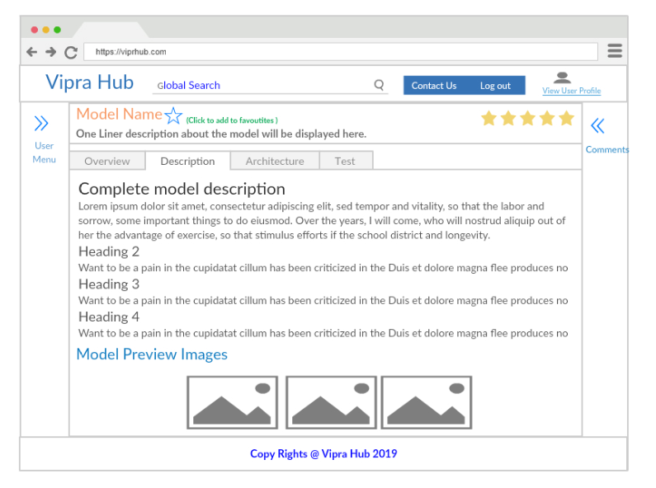

Slide 21
